Slide 1
Joshua Leicht

Slide 2
Agenda
About Me
Work Experience
Project:
Project Requirements
Project Accomplishments
Lessons Learned
Q & A session

Slide 3
About Me

Slide 4
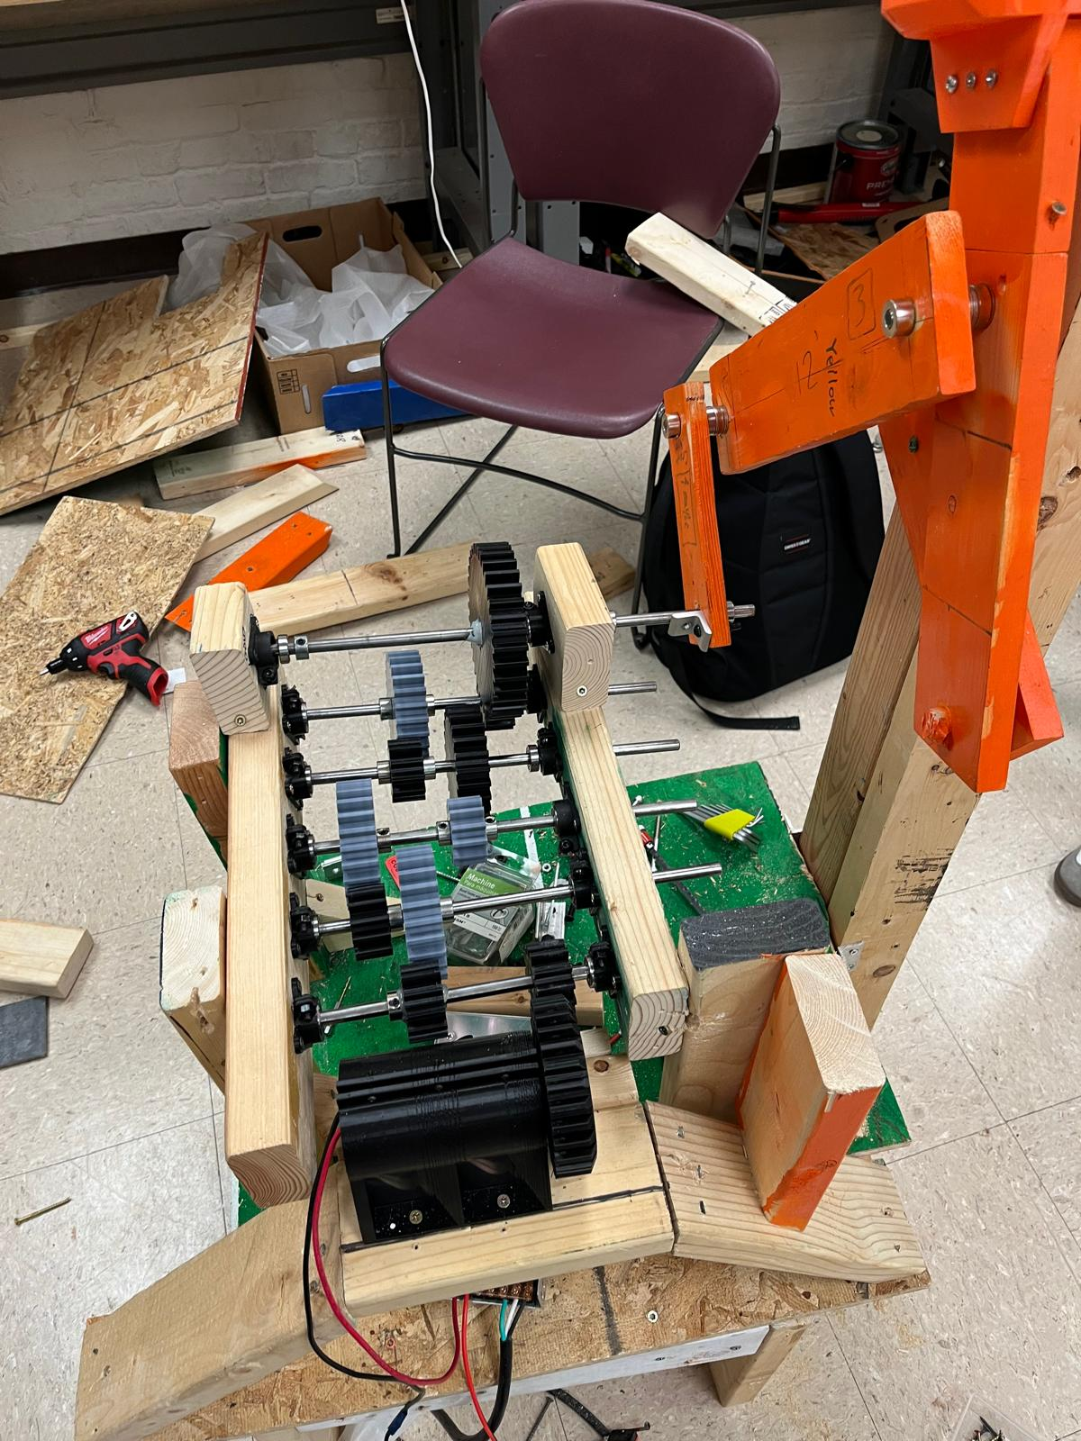
Education:
University of Illinois Urbana Champaign
Bachelors of Science in Mechanical engineering
GPA: 3.93
Graduation: May 2025
ASME:
Special Projects: “Pop-A-Shot”

Slide 5
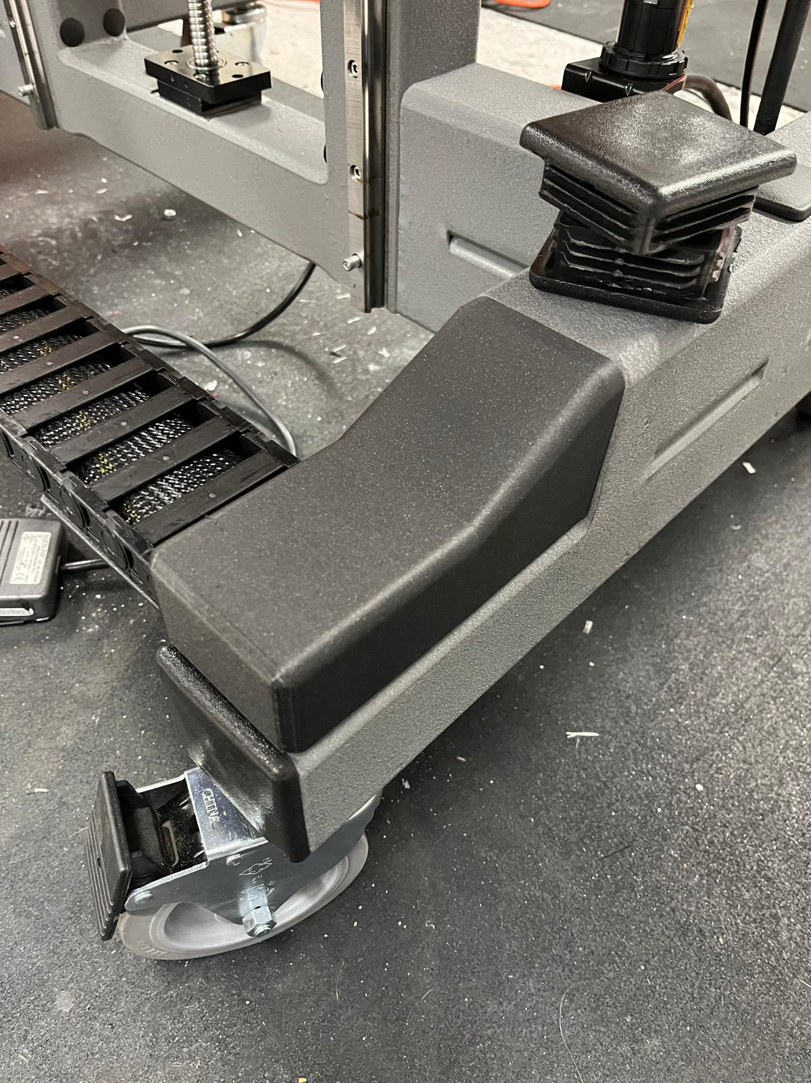
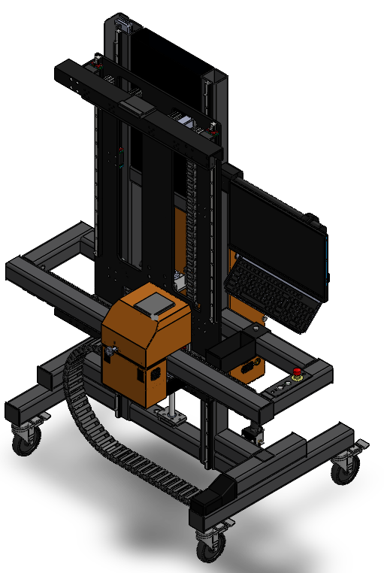
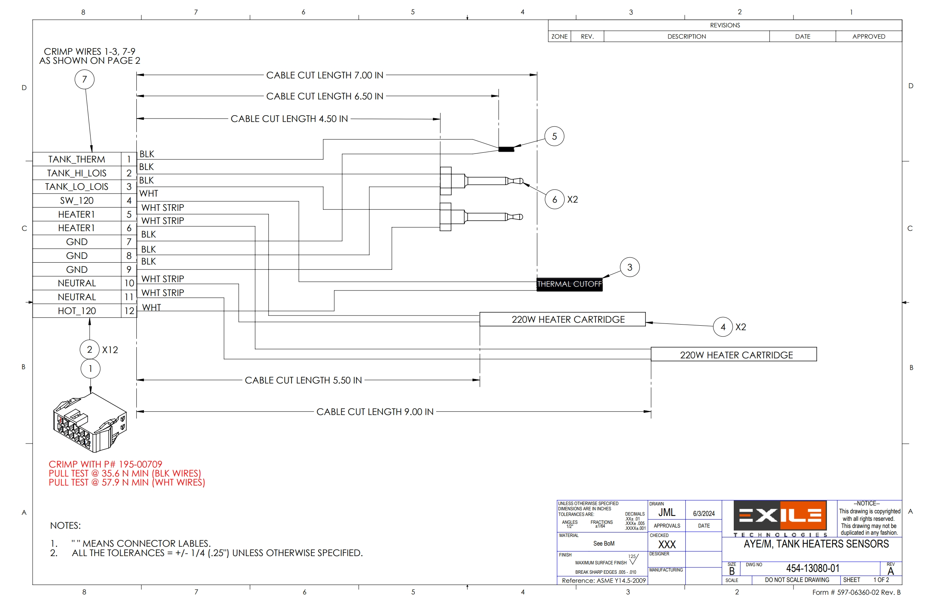
Employment Background
Exile Design Internship: May 2024 - August 2024
- Designed 3D-Printable Covers - Created the complete Spyder X assembly in CAD - Created assembly drawings for various sub-assemblies
Exile Design Internship: May 2023 - August 2024
- Designed ink wiper system - Tested water contents in ink

Slide 6
Exile Technologies Wiper Design

Slide 7
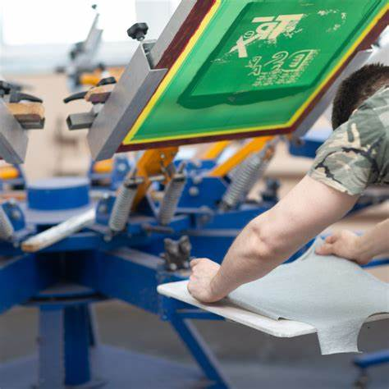
Background:
Silk Screen Printing:
- Typically used in Custom T-Shirt manufacturing: - Starts with screen coated in uncured emulsion - Wax based ink is applied in shape of image - Entire screen is cured except for wax coated areas - Screen is washed and ready to use - Wax application is a process like paper ink-jet printers - Alternate applications focus on higher resolution (1200 DPI)

Slide 8
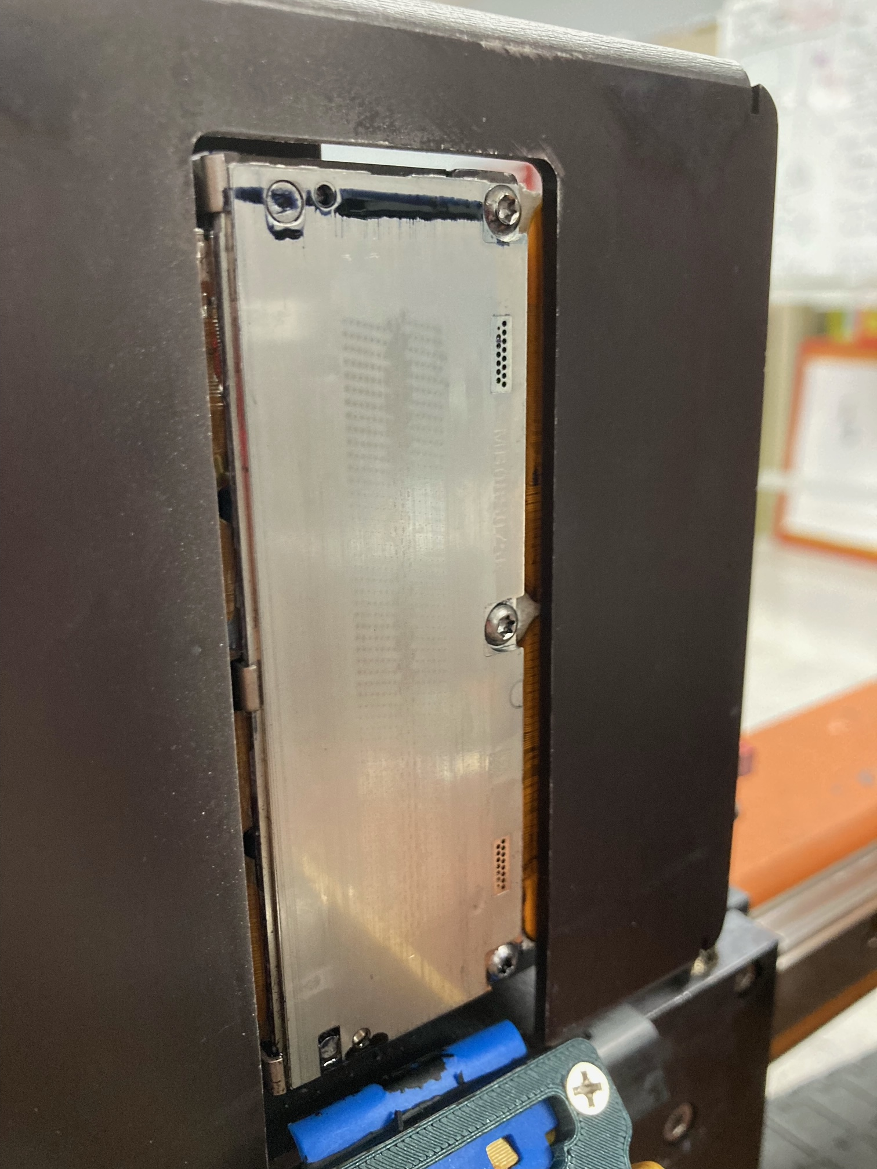
Project Description:
- Higher resolution printers require cleaner environments
- Frequent maintenance includes purging the printhead:
- During purges excess ink is pushed out of the ink head
- Ink head must be wiped before printing can continue
- Current solution is manual wiping by the user

Slide 9
Project Requirements:
- Wiping device must effectively remove excess ink without damaging the printhead (especially individual jets)
- Must wipe entire print head in a smooth, continuous motion (3.5 inches of travel)
- Must have a travel flatness within a range of ± 0.05 in
- Must hold wiper at a relatively constant angle with respect to print head throughout motion ( ±5°)
- Wipers Must be easily replaced by customer
- Must be installable in field without significant modification to Spyder 3
- Should not add exposed wires or valves
- Should be Cost effective

Slide 10
My Role

Slide 11
My role:
- Design the wiping system
- Create and 3D print test models and prototypes
- Create the working drawings for production
- Source raw materials for machining
- Communicate with vendors for purchase parts
- Communicate with external manufacturers and post processing facilities
- Test and assemble the prototypes

Slide 12
Accomplishments

Slide 13
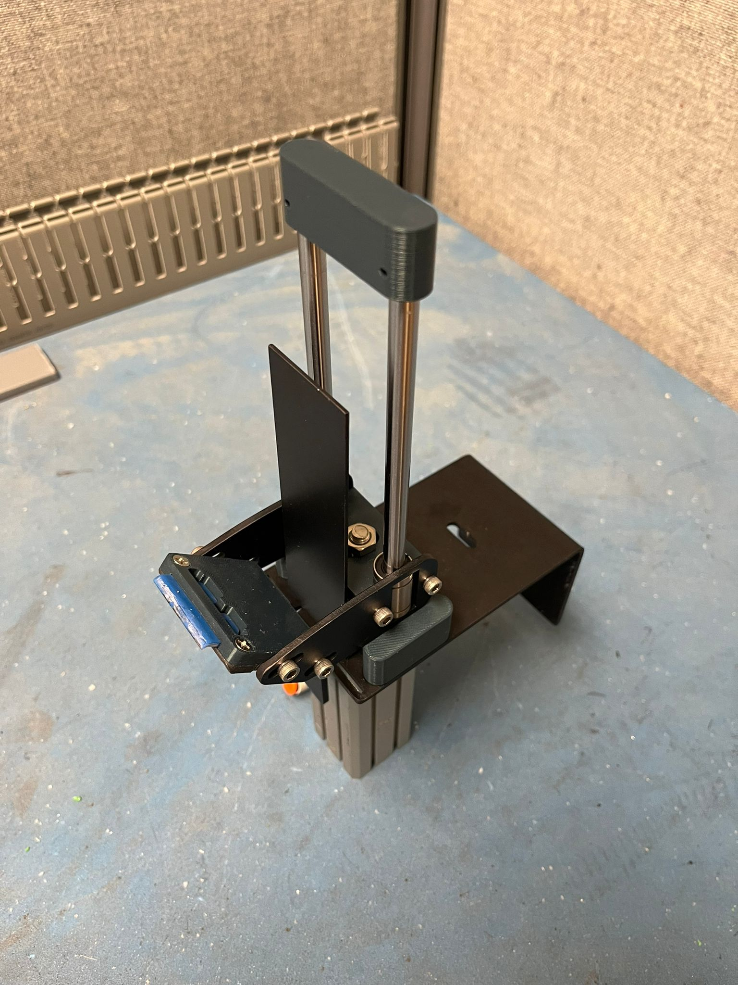
Completed Prototype
- Externally manufactured 5052 laser cut parts
- Type II black anodized finish
- 3D-printed PLA mock machine parts

Slide 14
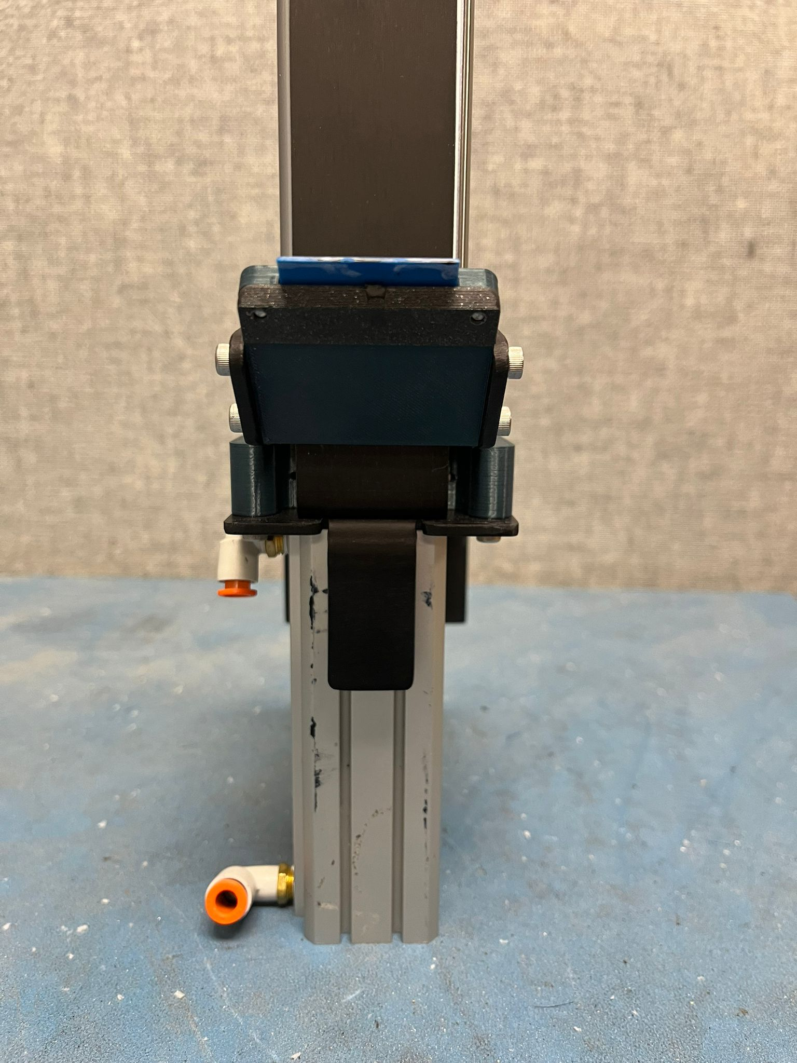
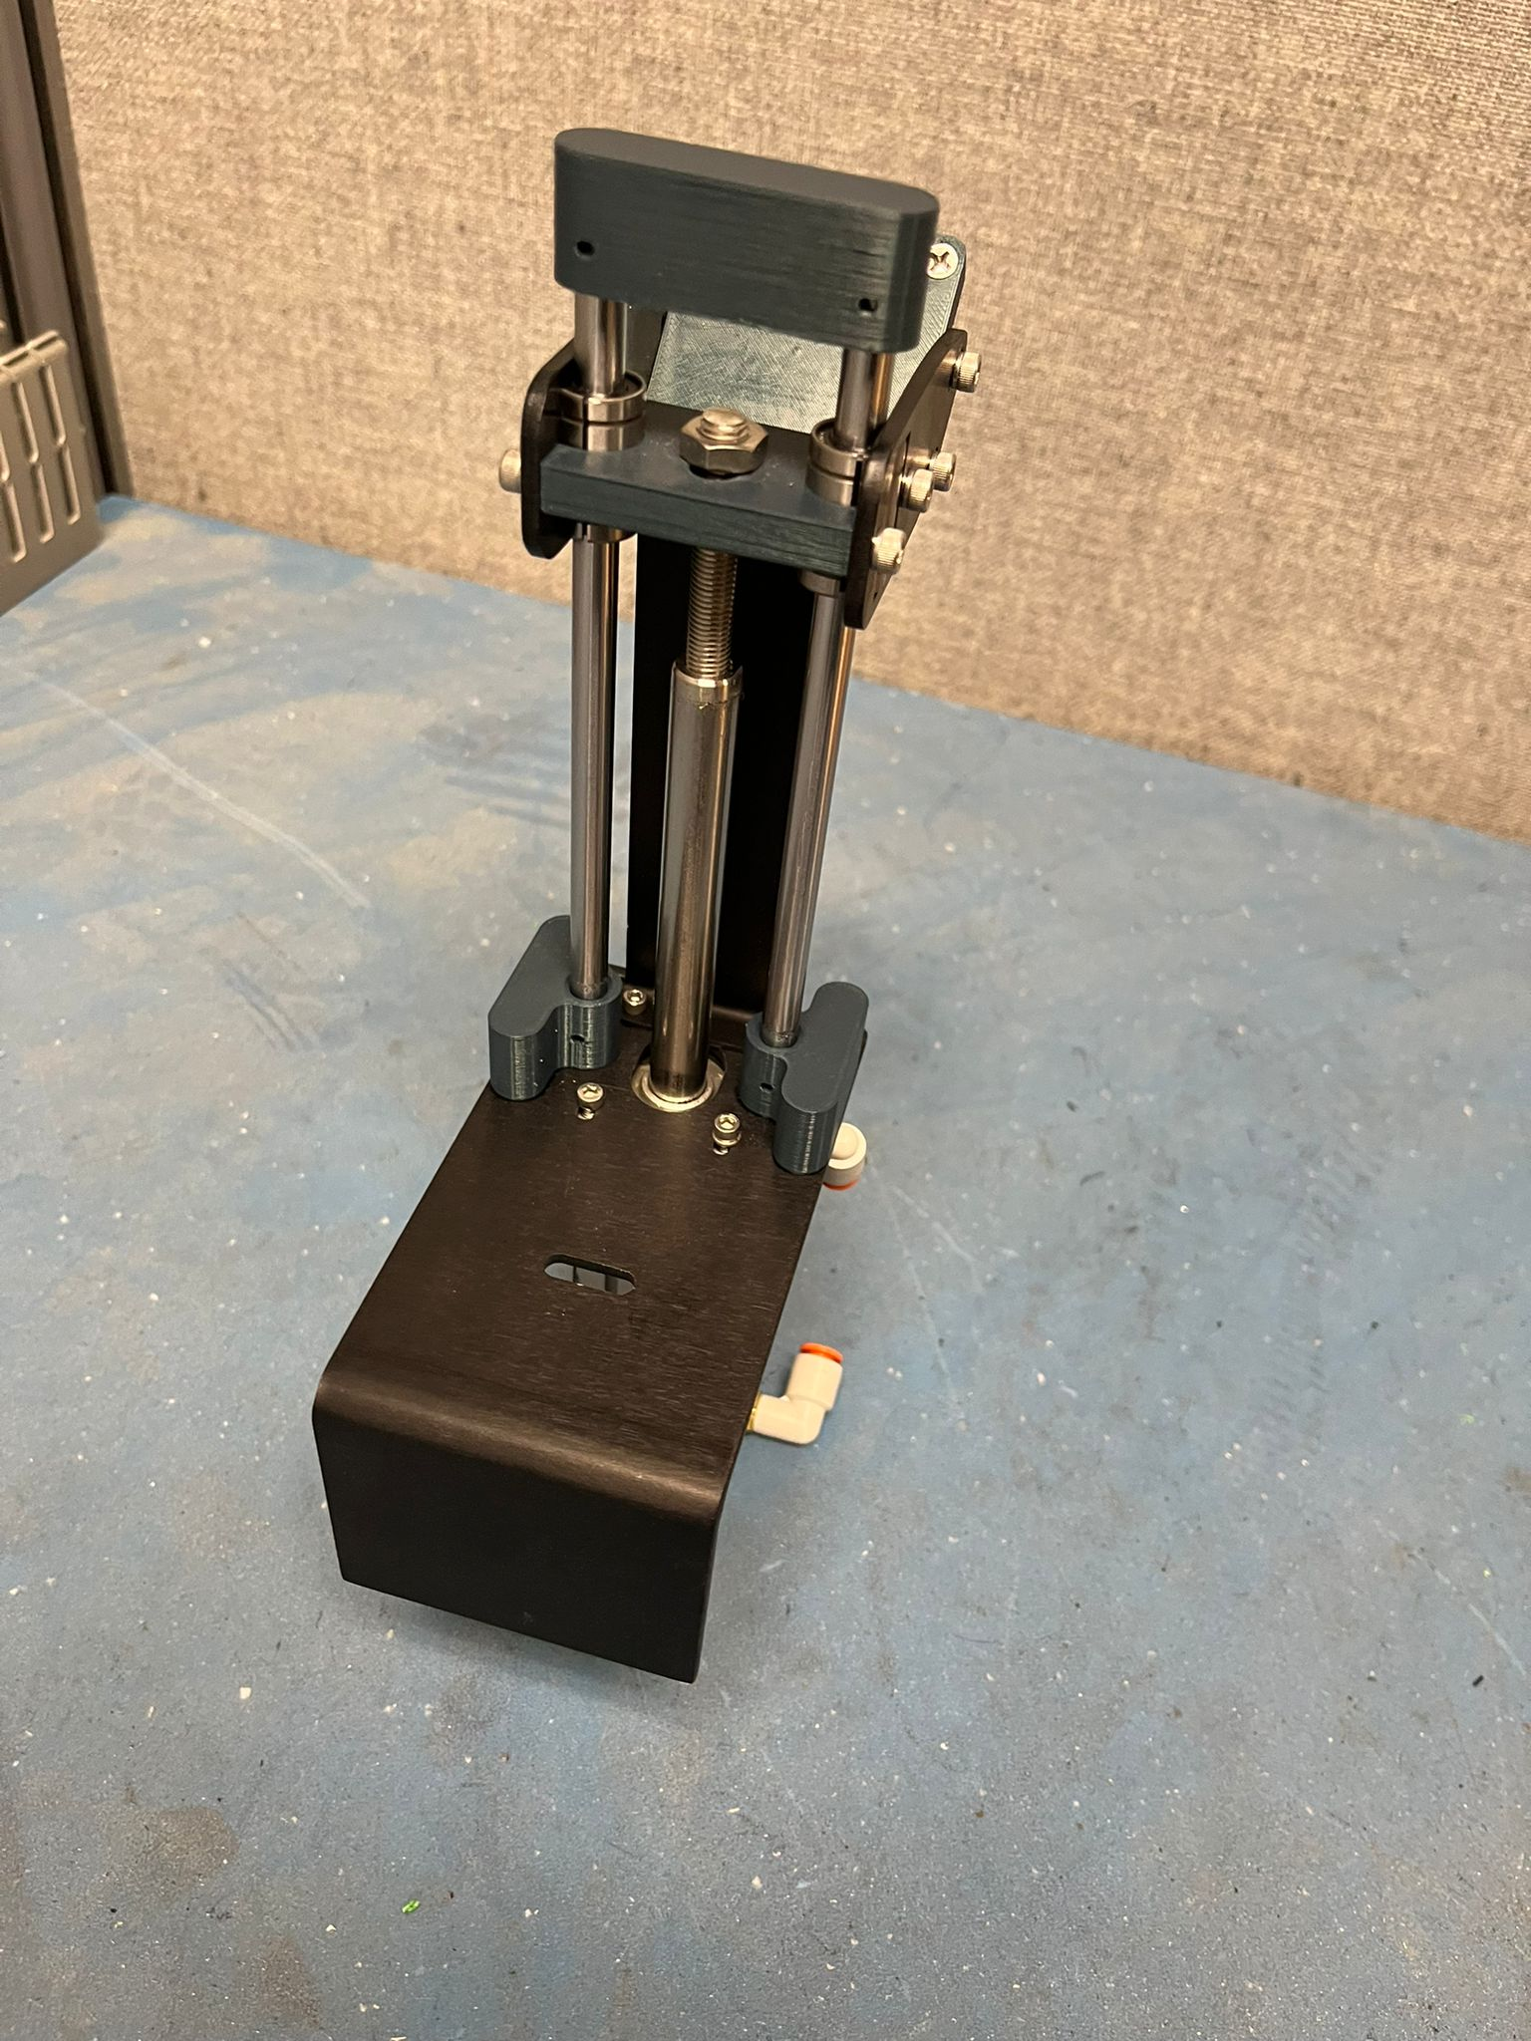
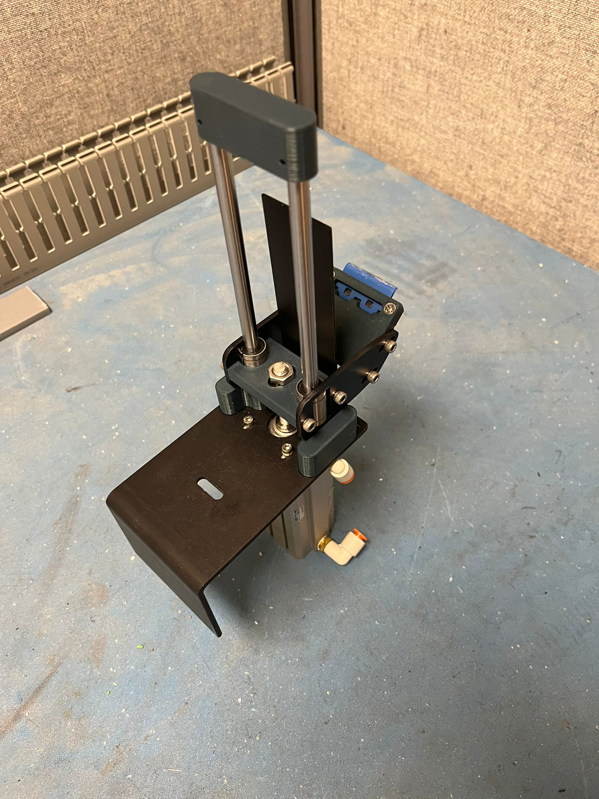
Alternate Views of Prototype

Slide 15
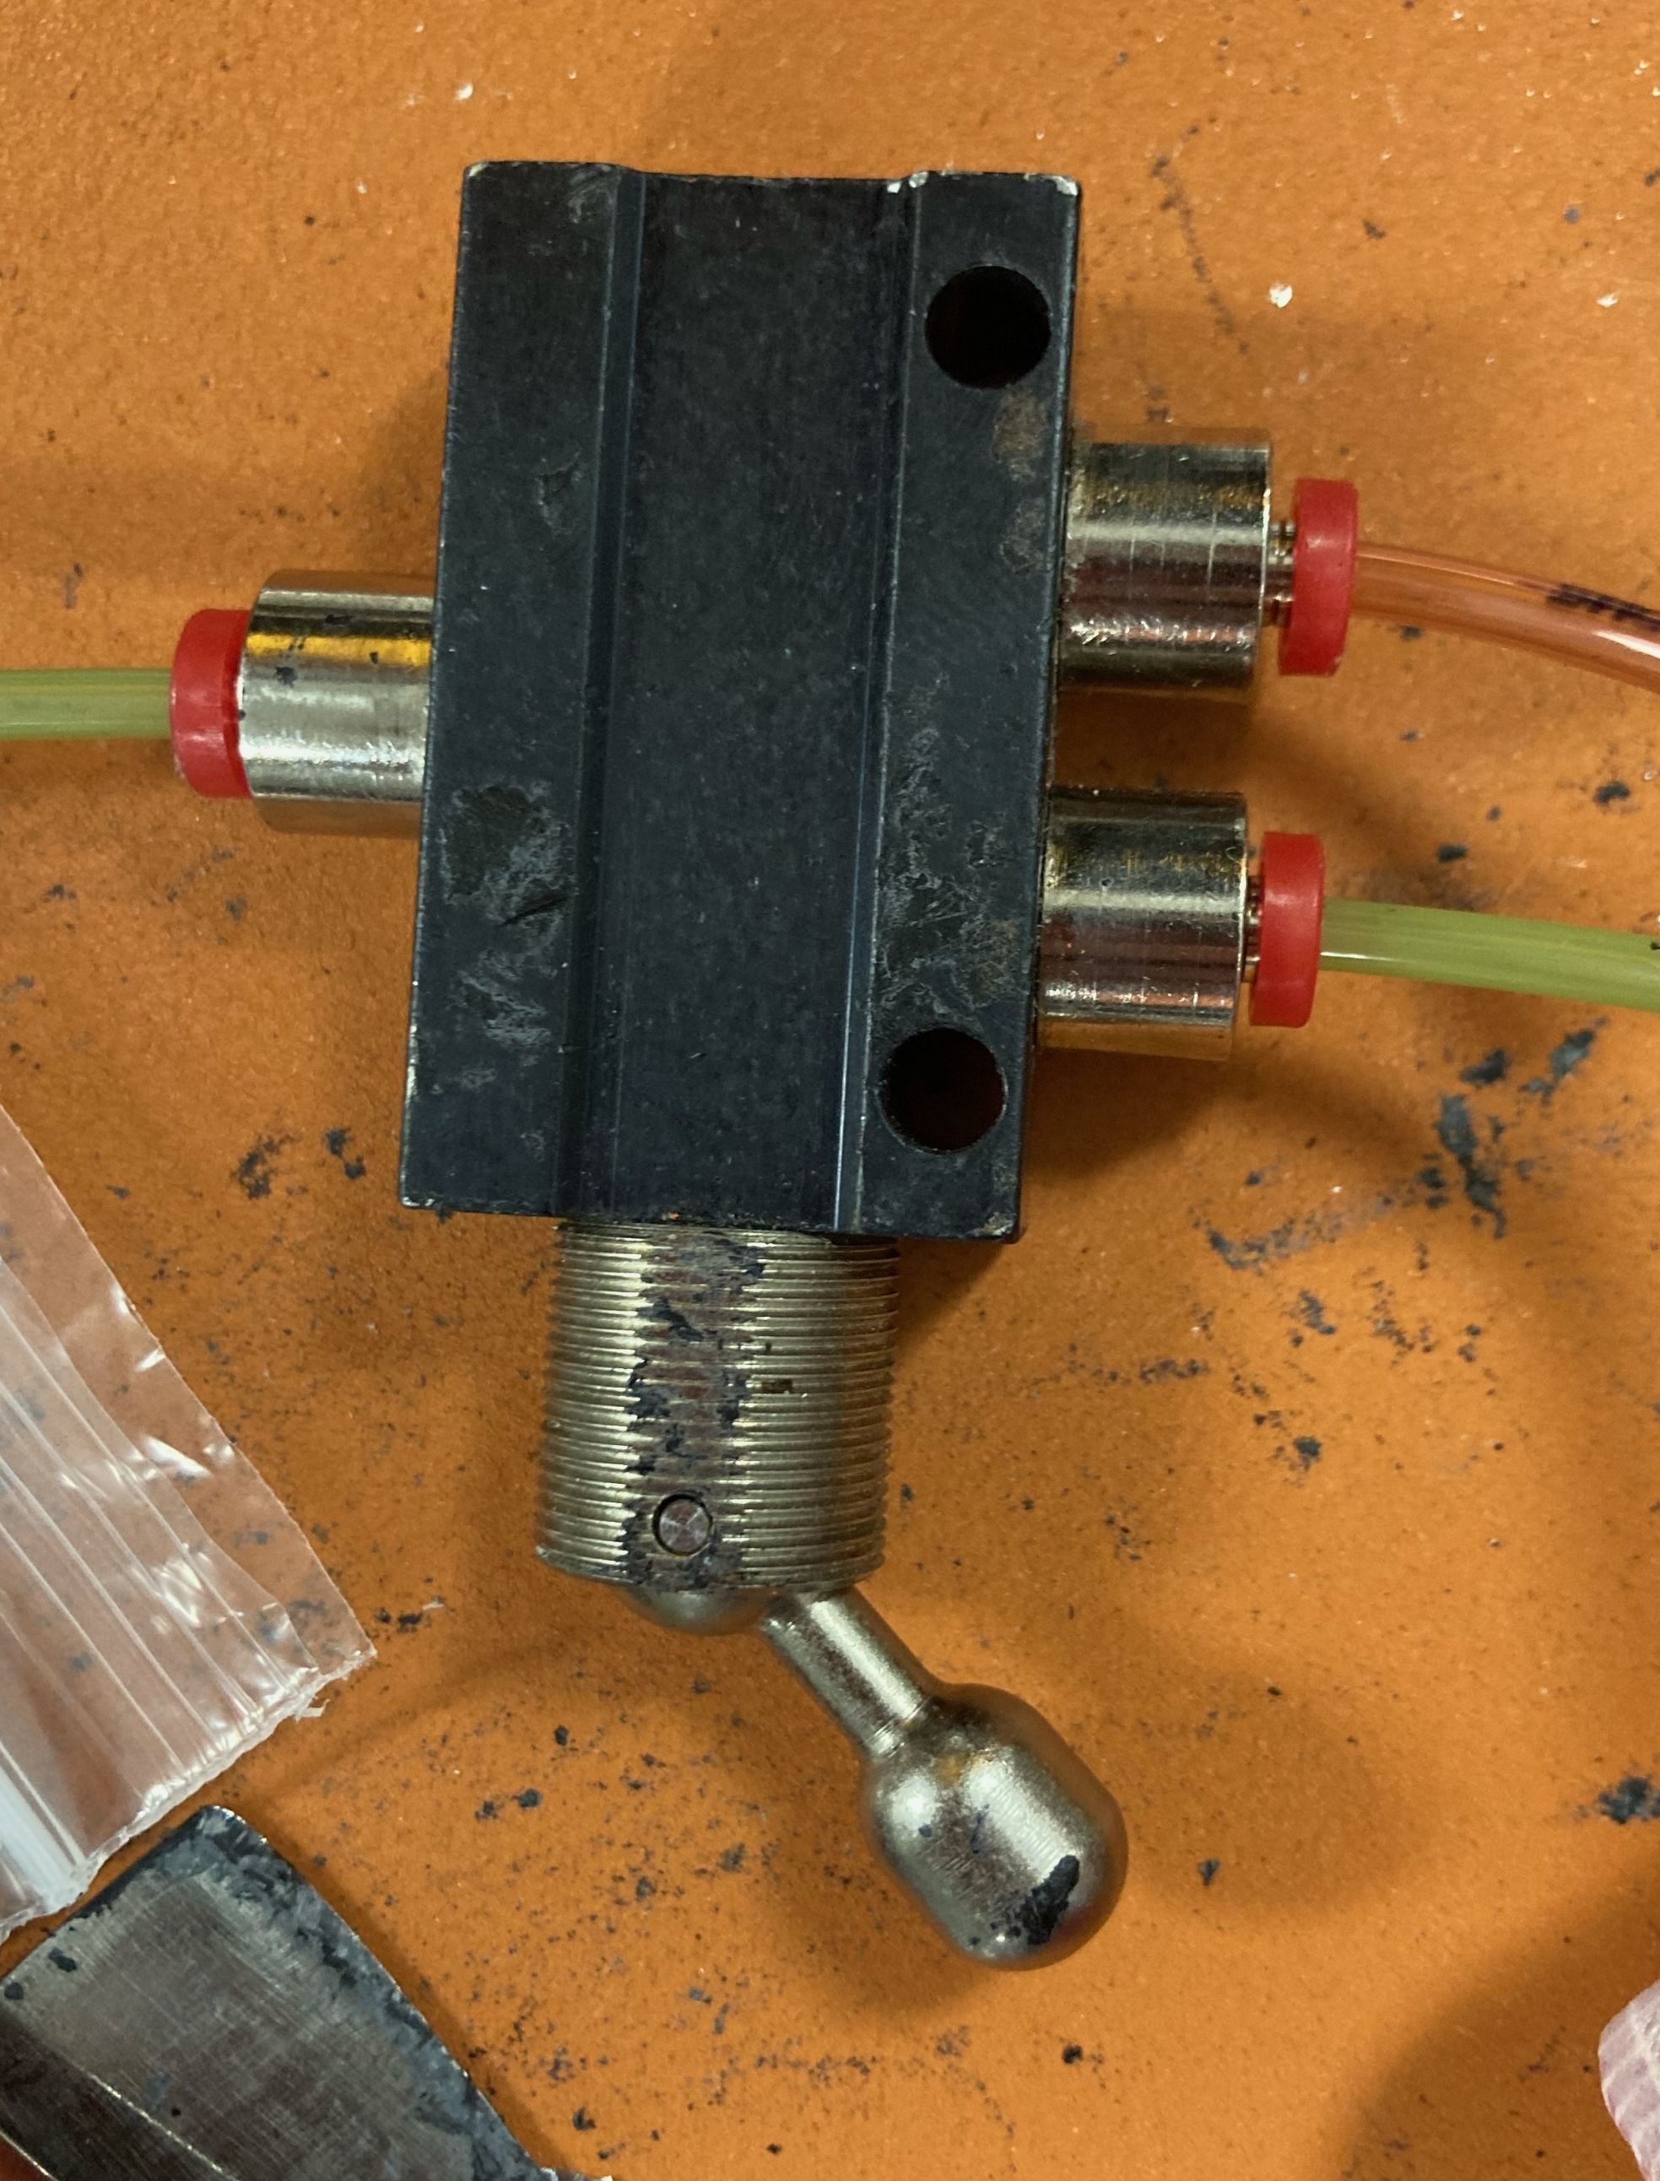
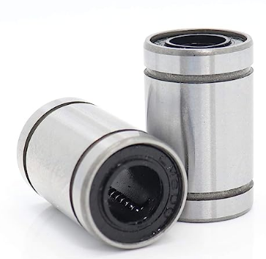
Motion Components
- LMU88 8mm Roller bearings and shafts
- SMC NCQ8-A075-400
- 0.75” Bore, 4” stroke, 80 psi typ.
- Controlled via external switch
- Future internal solenoid control
- Various fittings necessary for pneumatic cylinder

Slide 16
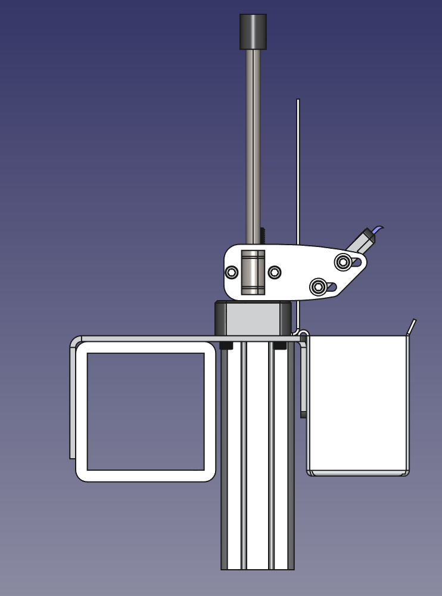
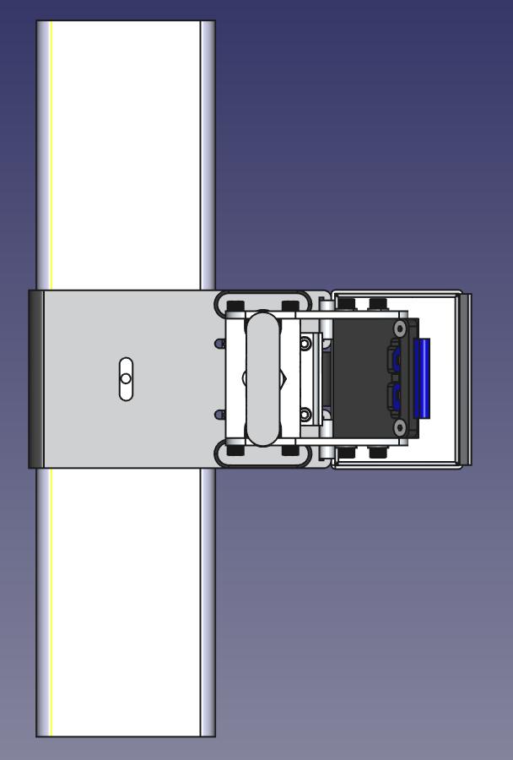
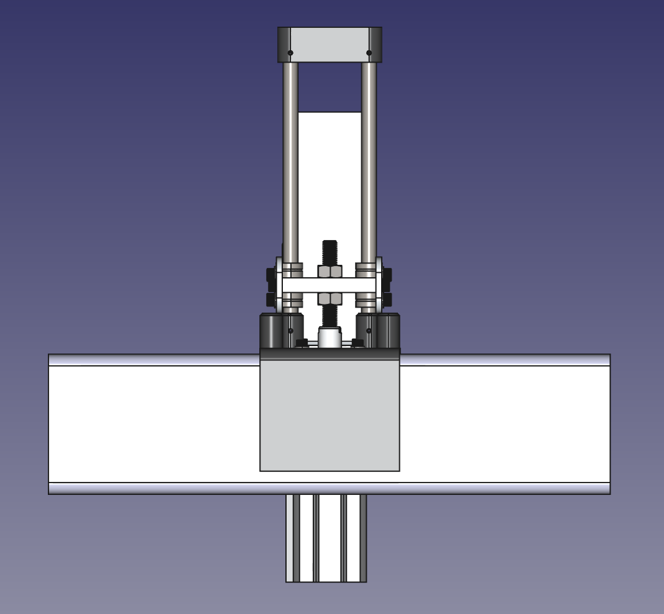
Adjustability
- Contains X, Y, and Z adjustability for wiper
- Contains Z-adjustability for piston
- Clamps to Spyder frame
- Pneumatic valve speed controllers
- Mounts to frame using single 10-32 screw

Slide 17
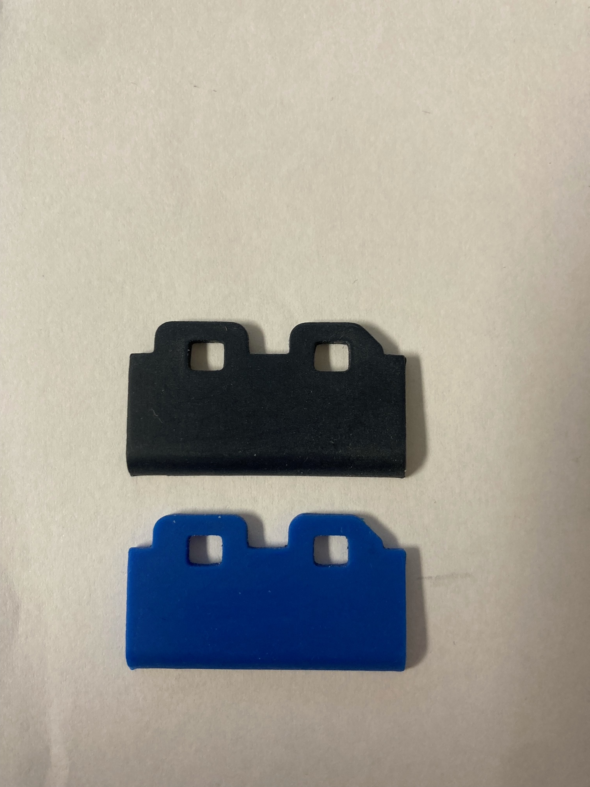
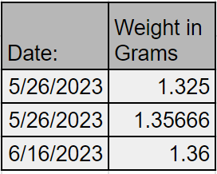
Commercially Available Wiper
- Wiper selection recommended by Xerox
- No issues with wiper sloughing material (Data Below)
- Push fit with tool removal (tweezers or a knife blade)
- Numerous suppliers with a cost of around $1.71

Slide 18
Lessons Learned

Slide 19
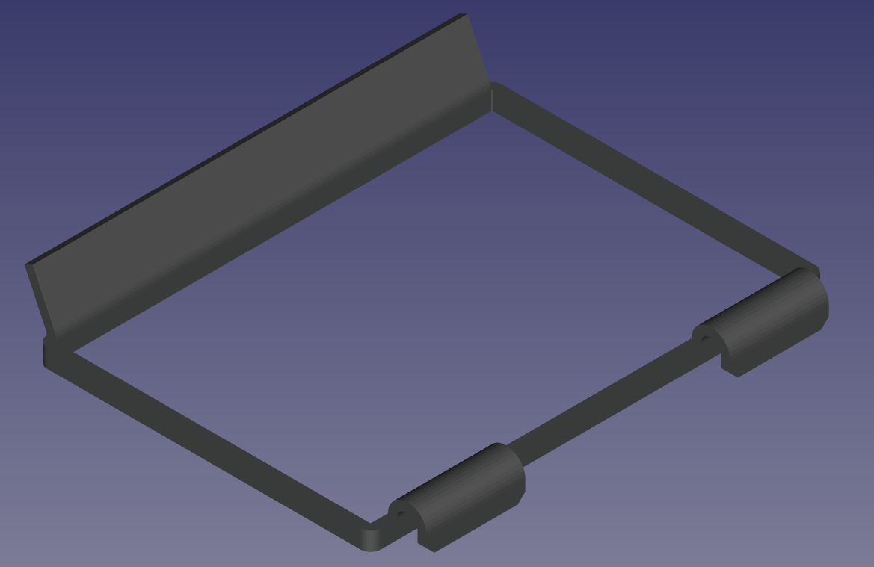
Key Lessons
- Ink reservoir tray did not line up with the drip shield on print head
- Some small modifications were made between the final print prototype and the sent out working drawings
- Inspection was only done using CAD models instead
Take Away:
- TEST, TEST, TEST!!!!!!!!
- Low fidelity prototypes are always better than CAD models

Slide 20
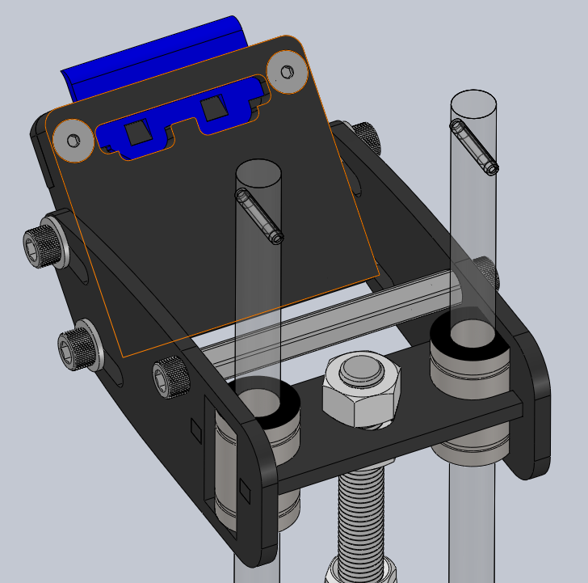
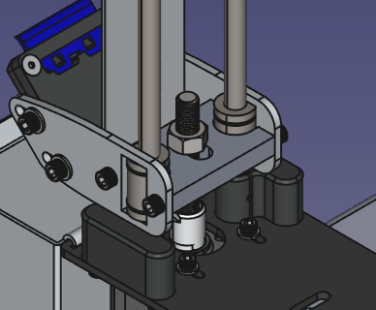
Key Lessons
- Taught in school that stamping/flat parts are best
- Exile Technologies did not have those capabilities in house
- Reducing part numbers by machining may have been a better solution
Take Away:
- Manufacturing preferences taught in school are not always best

Slide 21
Higher Level Takeaways
- There is no right answer in engineering
- In school you are taught to find the right answer
- There are practically an infinite number of ways to do something
- Things cost money
- Companies move at a much faster rate when it comes to spending money

Slide 22
Questions?

Slide 23
Backup Slides

Slide 24
Sources
Best Silk Screen Printing Services in Calgary [Updated 2025]

Slide 25
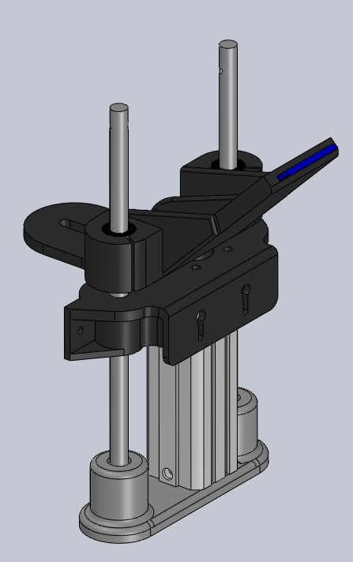
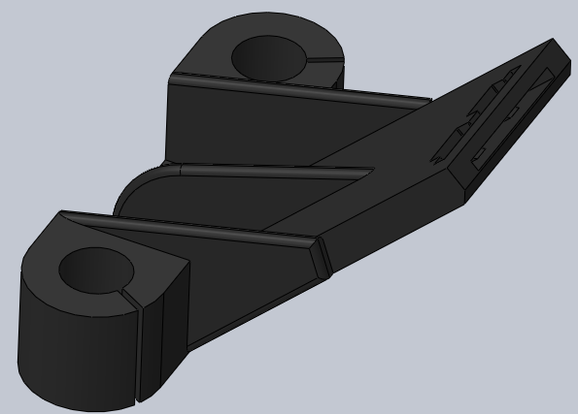
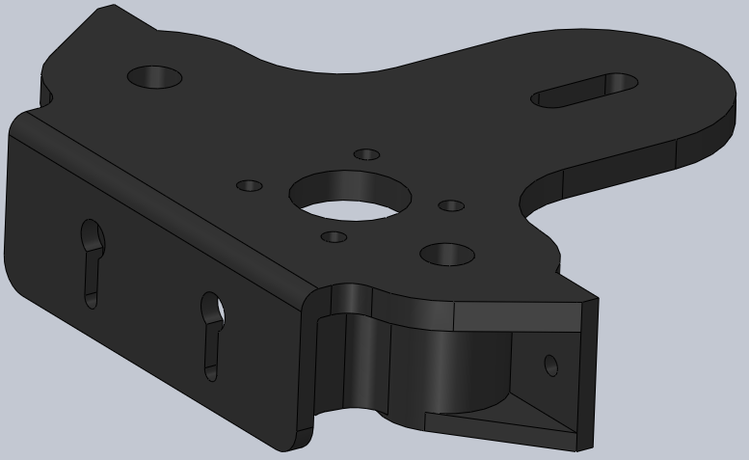
Concept Testing
Purpose: rapidly test the use of pneumatic piston for wiping
Design Issues:
-Flex in upper base plate
-Lack of x,y,z adjustments
-Difficult to conventionally manufacture

Slide 26
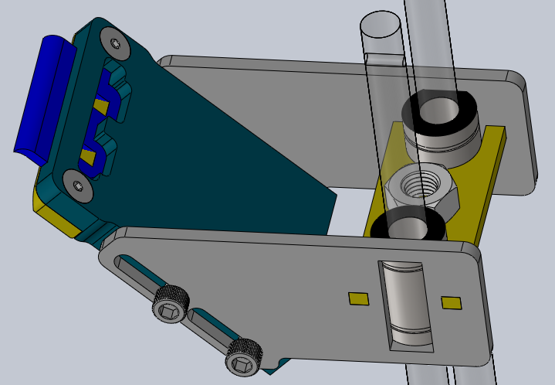
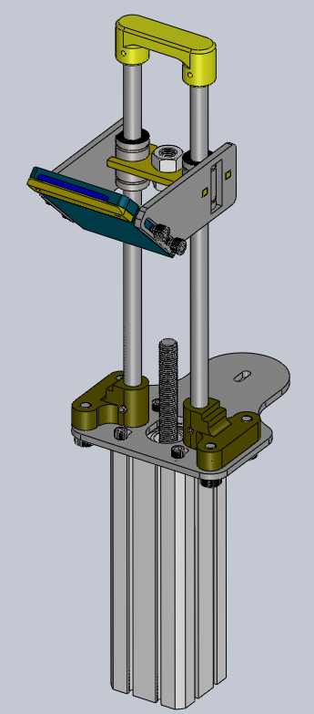
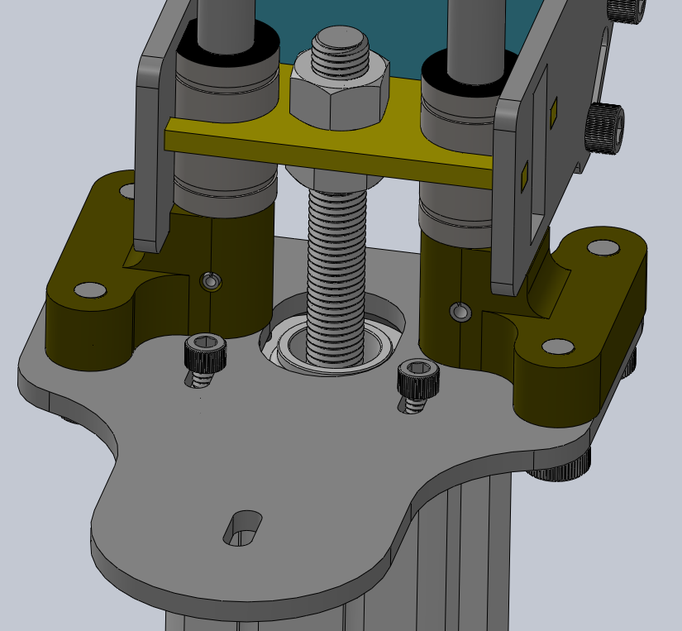
Initial Prototype
Purpose: provide a machinable, 3d printed test bed
Design Issues:
-Axis adjustment (X-axis)
-Design for assembly
-Plastic flexing

Slide 27
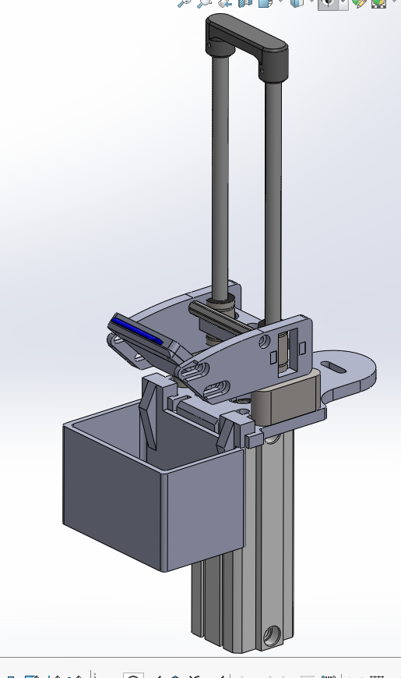
Version 2.9
Old style hardware
Designed for printing
Reduced bucket size
Currently in construction

Slide 28
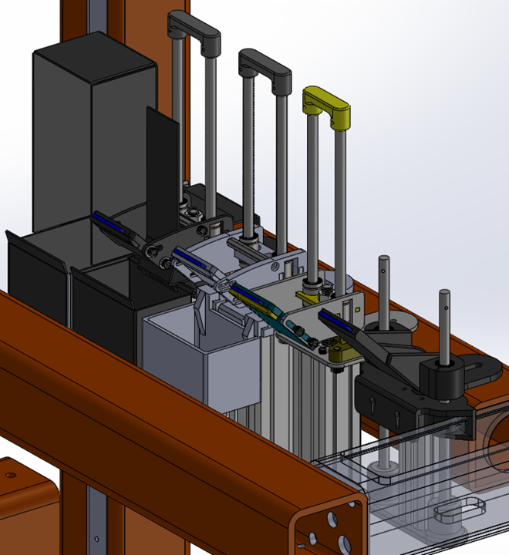
Iterations

Slide 29
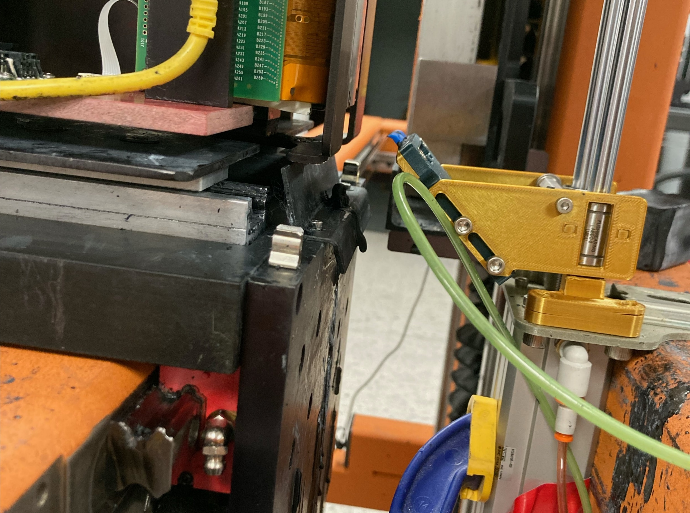
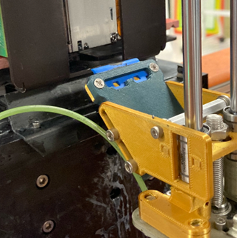
Location with respect to print head

Slide 30
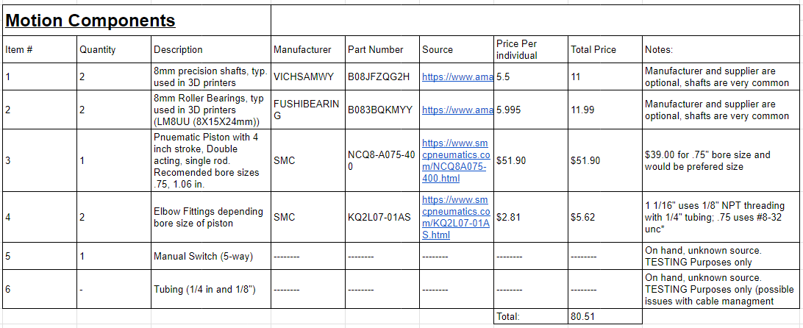
Motion Component Costs

Slide 31
Critical Issues
Initial Residue spot on the top of the print head – Fixed using different speeds
Ink “flick” deposits at end of travel – Unsolved
Cable management- two air hoses – Unsolved
Pinch points- beneath the wiper arms – Addition of boxed structure
Ink build up on the underside of the wiper – Unsolved

Slide 32
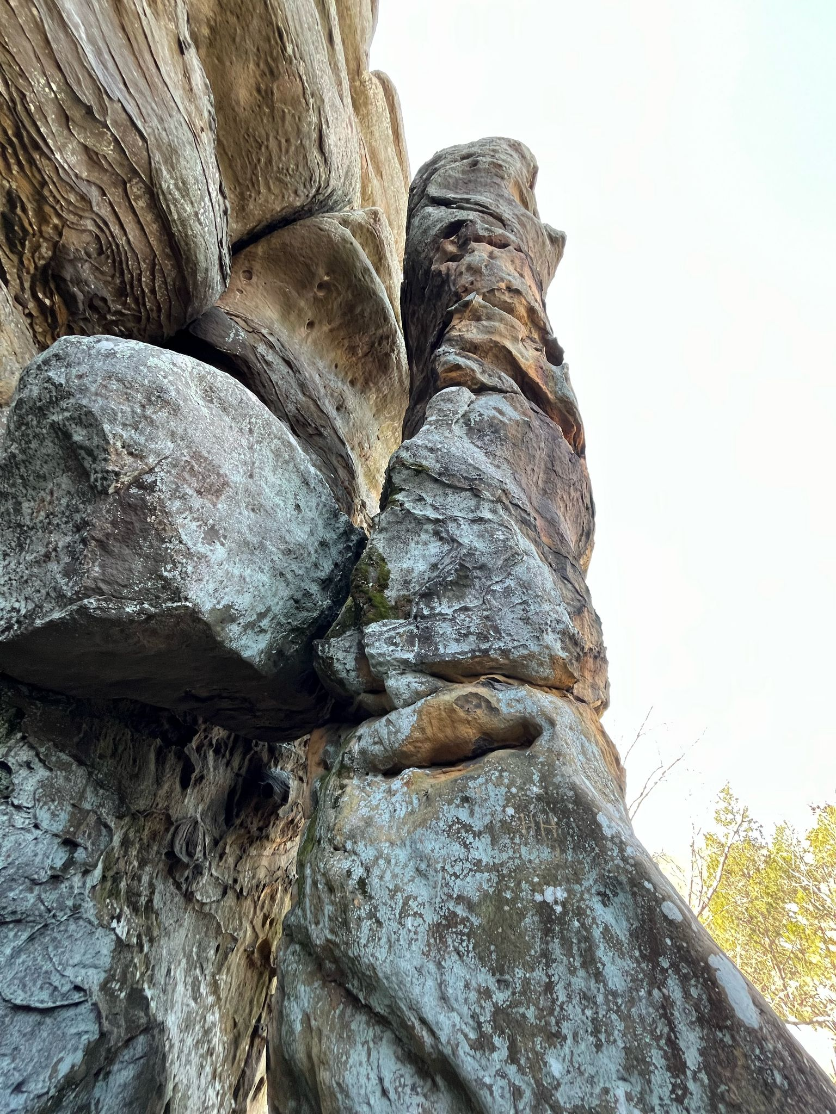

About Me
- I love to hike, camp, spend time in nature
- I have a 3D printer that I create a lot of parts for
- I enjoy going to the gym and playing basketball
- I help my dad with projects around the house including:
- Car maintenance
- Water heater exchange
- Fence construction
- Much more

